Slide 1
Crash Recovery

Slide 2
Topics
Crash recovery
Log-based
Immediate database modification
Deferred database modification
Shadow-paging

Slide 3
Failure Classification
Transaction failure :
Logical errors: transaction cannot complete due to some internal error condition
System errors: the database system must terminate an active transaction due to an error condition (e.g., deadlock)
System crash: a power failure or other hardware or software failure causes the system to crash.
Fail-stop assumption: non-volatile storage contents are assumed to not be corrupted by system crash
Database systems have numerous integrity checks to prevent corruption of disk data
Disk failure: a head crash or similar disk failure destroys all or part of disk storage
Destruction is assumed to be detectable: disk drives use checksums to detect failures

Slide 4
Recovery Algorithms
Recovery algorithms are techniques to ensure database consistency and transaction atomicity and durability despite failures
Recovery algorithms have two parts
Actions taken during normal transaction processing to ensure enough information exists to recover from failures
Actions taken after a failure to recover the database contents to a state that ensures atomicity, consistency and durability

Slide 5
Storage Structure
Volatile storage:
does not survive system crashes
examples: main memory, cache memory
Nonvolatile storage:
survives system crashes
examples: disk, tape, flash memory, non-volatile (battery backed up) RAM
but may still fail, losing data
Stable storage:
a mythical form of storage that survives all failures
approximated by maintaining multiple copies on distinct nonvolatile media

Slide 6
Data Access
Physical blocks are those blocks residing on the disk.
Buffer blocks are the blocks residing temporarily in main memory.
Block movements between disk and main memory are initiated through the following two operations:
input(B) transfers the physical block B to main memory.
output(B) transfers the buffer block B to the disk, and replaces the appropriate physical block there.
Each transaction T_{i} has its private work-area in which local copies of all data items accessed and updated by it are kept.
T_{i}'s local copy of a data item X is called x_{i}.
We assume, for simplicity, that each data item fits in, and is stored inside, a single block.

Slide 7
Data Access
Transaction transfers data items between system buffer blocks and its private work-area using the following operations :
read(X) assigns the value of data item X to the local variable x_{i}.
write(X) assigns the value of local variable x_{i} to data item {X} in the buffer block.
both these commands may necessitate the issue of an input(B_{X}) instruction before the assignment, if the block B_{X} in which X resides is not already in memory.

Slide 8
Data Access
Transactions
Perform read(X) while accessing X for the first time;
All subsequent accesses are to the local copy.
After last access, transaction executes write(X).
output(B_{X}) need not immediately follow write(X). System can perform the output operation when it deems fit.

Slide 9
Example of Data Access
buffer
Buffer Block A
x
input(A)
Buffer Block B
Y
A
output(B)
B
read(X)
write(Y)
x₂
disk
x₁
y₁
work area
of T₁
work area
of T₂
memory

Slide 10
Recovery & Atomicity
Modifying the database without ensuring that the transaction will commit may leave the database in an inconsistent state.
Consider transaction T_{i} that transfers $50 from account A to account B; goal is either to perform all database modifications made by T_{i} or none at all.
Several output operations may be required for T_{i} (to output A and B). A failure may occur after one of these modifications have been made but before all of them are made.

Slide 11
Recovery & Atomicity
To ensure atomicity despite failures, we first output information describing the modifications to stable storage without modifying the database itself.
We study two approaches:
log-based recovery, and
shadow-paging
We assume (initially) that transactions run serially, that is, one after the other.

Slide 12
Log-Based Recovery
A log is kept on stable storage.
The log is a sequence of log records, and maintains a record of update activities on the database.
When transaction T_{i} starts, it registers itself by writing a <T_{i} start>log record
Before T_{i} executes write(X), a log record <T_{i}, X, V₁, V₂> is written, where V₁ is the value of X before the write, and V₂ is the value to be written to X.
Log record notes that T_{i} has performed a write on data item X_{j} X_{j} had value V₁ before the write, and will have value V₂ after the write.
When T_{i} finishes it last statement, the log record <T_{i} commit> is written.
We assume for now that log records are written directly to stable storage (that is, they are not buffered)

Slide 13
Log-Based Recovery
Two approaches using logs:
Deferred database modification
Immediate database modification

Slide 14
Deferred Database Modification
The deferred database modification scheme records all modifications to the log, but defers all the writes to after partial commit.
Assume that transactions execute serially
Transaction starts by writing <T_{i} start> record to log.
A write(X) operation results in a log record <T_{i}, X, V> being written, where V is the new value for X
Note: old value is not needed for this scheme
The write is not performed on X at this time, but is deferred.
When T_{i} partially commits, <T_{i} commit> is written to the log
Finally, the log records are read and used to actually execute the previously deferred writes.

Slide 15
Deferred Database Modification
During recovery after a crash, a transaction needs to be redone if and only if both <T_{i} start> and<T_{i} commit> are there in the log.
Redoing a transaction T_{i} ( redoT_{i}) sets the value of all data items updated by the transaction to the new values.
Crashes can occur while
the transaction is executing the original updates, or
while recovery action is being taken
example transactions T₀ and T₁ (T₀ executes before T₁):
T₀: read (A) T₁ : read (C)
A: - A - 50 C:-C- 100
Write (A) write (C)
read (B)
B:- B + 50
write (B)

Slide 16
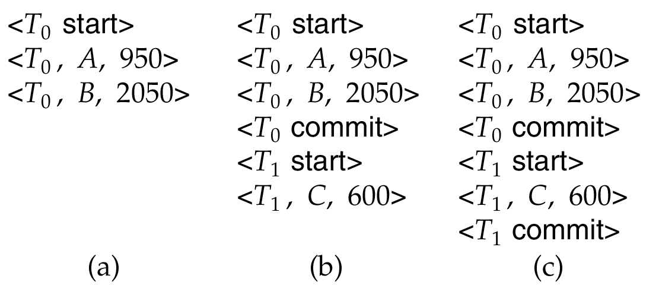
Deferred Database Modification
Below we show the log as it appears at three instances of time.
If log on stable storage at time of crash is as in case:
(a) No redo actions need to be taken
(b) redo(T₀) must be performed since <T₀ commit> is present
(c) redo(T₀) must be performed followed by redo(T₁) since
<T₀ commit> and <T_{i} commit> are present

Slide 17
Immediate Database Modification
The immediate database modification scheme allows database updates of an uncommitted transaction to be made as the writes are issued
since undoing may be needed, update logs must have both old value and new value
Update log record must be written before database item is written
We assume that the log record is output directly to stable storage
Can be extended to postpone log record output, so long as prior to execution of an output(B) operation for a data block B, all log records corresponding to items B must be flushed to stable storage

Slide 18
Immediate Database Modification
Output of updated blocks can take place at any time before or after transaction commit
Order in which blocks are output can be different from the order in which they are written.

Slide 19
Immediate Database Modification Example
Log Write Output
<T₀ start>
<T₀, A, 1000, 950>
<T_{o}, B, 2000, 2050>
A = 950
B = 2050
<T₀ commit>
<T₁ start>
<T₁, C, 700, 600>
C = 600
B_{B}, B_{C}
<T₁ commit>
B_{A}
Note: B_{X} denotes block containing X.

Slide 20
Immediate Database Modification
Recovery procedure has two operations instead of one:
undo(T_{i}) restores the value of all data items updated by T_{i} to their old values, going backwards from the last log record for T_{i}
redo(T_{i}) sets the value of all data items updated by T_{i} to the new values, going forward from the first log record for T_{i}
Both operations must be idempotent
That is, even if the operation is executed multiple times the effect is the same as if it is executed once
Needed since operations may get re-executed during recovery

Slide 21
Immediate Database Modification
When recovering after failure:
Transaction T_{i} needs to be undone if the log contains the record <T_{i} start>, but does not contain the record <T_{i} commit>.
Transaction T_{i} needs to be redone if the log contains both the record <T_{i} start> and the record <T_{i} commit>.
Undo operations are performed first, then redo operations.

Slide 22
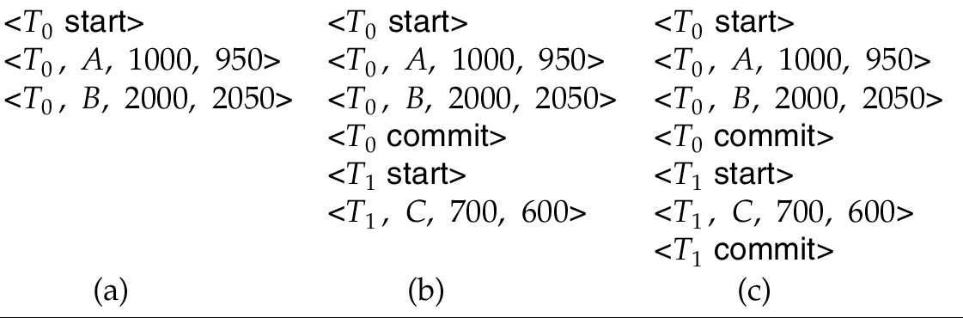
Immediate DB Modification Recovery Example
Below we show the log as it appears at three instances of time.
Recovery actions in each case above are:
(a) undo (T₀): B is restored to 2000 and A to 1000.
(b) undo (T₁) and redo (T₀): C is restored to 700, and then A and B are set to 950 and 2050 respectively.
(c) redo (T₀) and redo (T₁): A and B are set to 950 and 2050
respectively. Then C is set to 600

Slide 23
Checkpoints
Problems in recovery procedure as discussed earlier :
searching the entire log is time-consuming
we might unnecessarily redo transactions which have already output their updates to the database.
Streamline recovery procedure by periodically performing checkpointing
Output all log records currently residing in main memory onto stable storage.
Output all modified buffer blocks to the disk.
Write a log record < checkpoint> onto stable storage.

Slide 24
Checkpoints
During recovery we need to consider only the most recent transaction T_{i} that started before the checkpoint, and transactions that started after T_{i}.
Scan backwards from end of log to find the most recent <checkpoint> record
Continue scanning backwards till a record <T_{i} start> is found.
Need only consider the part of log following above start record. Earlier part of log can be ignored during recovery, and can be erased whenever desired.
For all transactions (starting from T_{i} or later) with no <T_{i} commit>, execute undo(T_{i}). (Done only in case of immediate modification.)
Scanning forward in the log, for all transactions starting from T_{i} or later with a <T_{i} commit>, execute redo(T_{i}).

Slide 25
Example of Checkpoints
T₁ can be ignored (updates already output to disk due to checkpoint)
T₂ and T₃ redone.
T₄ undone
T_{c}
T_{f}
T₁
T₂
T₃
T₄
checkpoint
system failure

Slide 26
Shadow Paging
Shadow paging is an alternative to log-based recovery; this scheme is useful if transactions execute serially
Idea: maintain two page tables during the lifetime of a transaction –the current page table, and the shadow page table
Store the shadow page table in nonvolatile storage, such that state of the database prior to transaction execution may be recovered.
Shadow page table is never modified during execution

Slide 27
Shadow Paging
To start with, both the page tables are identical. Only current page table is used for data item accesses during execution of the transaction.
Whenever any page is about to be written for the first time
A copy of this page is made onto an unused page.
The current page table is then made to point to the copy
The update is performed on the copy

Slide 28
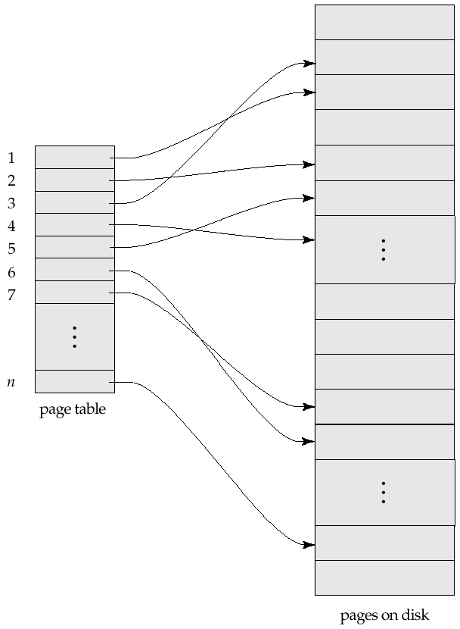
Sample Page Table

Slide 29
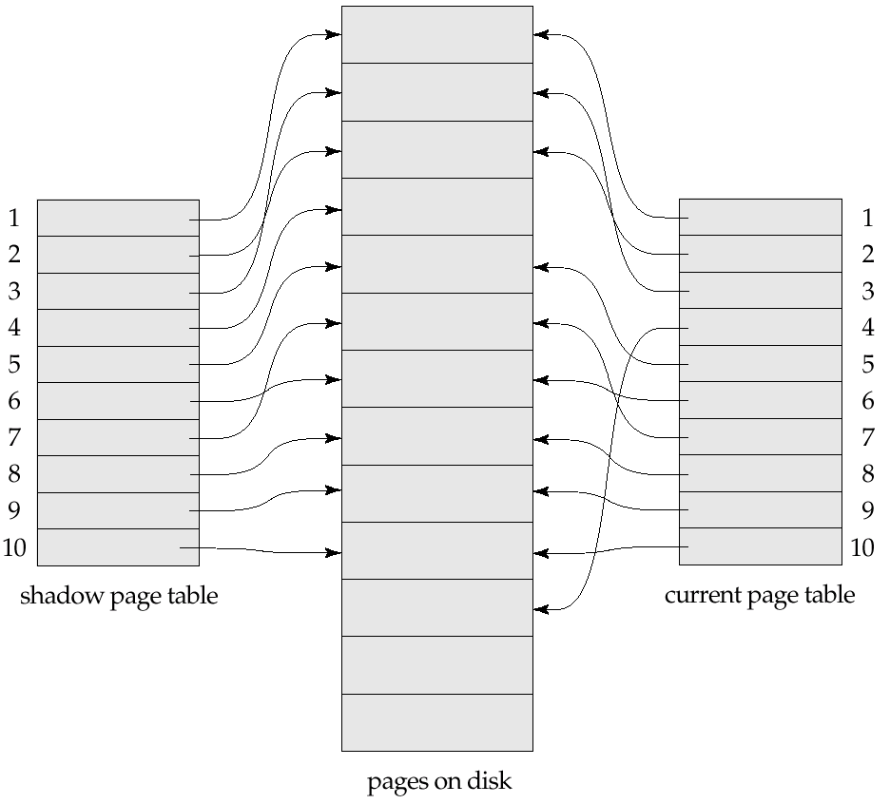
Example of Shadow Paging
Shadow and current page tables after write to page 4

Slide 30
Shadow Paging
To commit a transaction :
1. Flush all modified pages in main memory to disk
2. Output current page table to disk
3. Make the current page table the new shadow page table, as follows:
keep a pointer to the shadow page table at a fixed (known) location on disk.
to make the current page table the new shadow page table, simply update the pointer to point to current page table on disk

Slide 31
Shadow Paging
Once pointer to shadow page table has been written, transaction is committed.
No recovery is needed after a crash — new transactions can start right away, using the shadow page table.
Pages not pointed to from current/shadow page table should be freed (garbage collected)

Slide 32
Shadow Paging
Advantages of shadow-paging over log-based schemes
no overhead of writing log records
recovery is trivial

Slide 33
Shadow Paging
Disadvantages :
Copying the entire page table is very expensive
Can be reduced by using a page table structured like a B⁺-tree
No need to copy entire tree, only need to copy paths in the tree that lead to updated leaf nodes
Commit overhead is high even with above extension
Need to flush every updated page, and page table
Data gets fragmented (related pages get separated on disk)
After every transaction completion, the database pages containing old versions of modified data need to be garbage collected
Hard to extend algorithm to allow transactions to run concurrently
Easier to extend log based schemes

Slide 34
ARIES
ARIES is a state of the art recovery method
Incorporates numerous optimizations to reduce overheads during normal processing and to speed up recovery
The recovery algorithm we studied earlier is modeled after ARIES, but greatly simplified by removing optimizations
Unlike the recovery algorithm described earlier, ARIES
Uses log sequence number (LSN) to identify log records
Stores LSNs in pages to identify what updates have already been applied to a database page
Physiological redo
Dirty page table to avoid unnecessary redos during recovery
Fuzzy checkpointing that only records information about dirty pages, and does not require dirty pages to be written out at checkpoint time
More coming up on each of the above …

Slide 35
ARIES Optimizations
Physiological redo
Affected page is physically identified, action within page can be logical
Used to reduce logging overheads
e.g. when a record is deleted and all other records have to be moved to fill hole
Physiological redo can log just the record deletion
Physical redo would require logging of old and new values for much of the page
Requires page to be output to disk atomically
Easy to achieve with hardware RAID, also supported by some disk systems
Incomplete page output can be detected by checksum techniques,
But extra actions are required for recovery
Treated as a media failure

Slide 36
ARIES Data Structures
ARIES uses several data structures
Log sequence number (LSN) identifies each log record
Must be sequentially increasing
Typically an offset from beginning of log file to allow fast access
Easily extended to handle multiple log files
Page LSN
Log records of several different types
Dirty page table

Slide 37
ARIES Data Structures: Page LSN
Each page contains a PageLSN which is the LSN of the last log record whose effects are reflected on the page
To update a page:
X-latch the page, and write the log record
Update the page
Record the LSN of the log record in PageLSN
Unlock page
To flush page to disk, must first S-latch page
Thus page state on disk is operation consistent
Required to support physiological redo
PageLSN is used during recovery to prevent repeated redo
Thus ensuring idempotence

Slide 38
ARIES Data Structures: Log Record
Each log record contains LSN of previous log record of the same transaction
LSN in log record may be implicit
Special redo-only log record called compensation log record (CLR) used to log actions taken during recovery that never need to be undone
Serves the role of operation-abort log records used in earlier recovery algorithm
Has a field UndoNextLSN to note next (earlier) record to be undone
Records in between would have already been undone
Required to avoid repeated undo of already undone actions
LSN TransID PrevLSN RedoInfo UndoInfo
LSN TransID UndoNextLSN RedoInfo
1
2
3
4
4'
3'
2'
1'

Slide 39
ARIES Data Structures: DirtyPage Table
DirtyPageTable
List of pages in the buffer that have been updated
Contains, for each such page
PageLSN of the page
RecLSN is an LSN such that log records before this LSN have already been applied to the page version on disk
Set to current end of log when a page is inserted into dirty page table (just before being updated)
Recorded in checkpoints, helps to minimize redo work

Slide 40
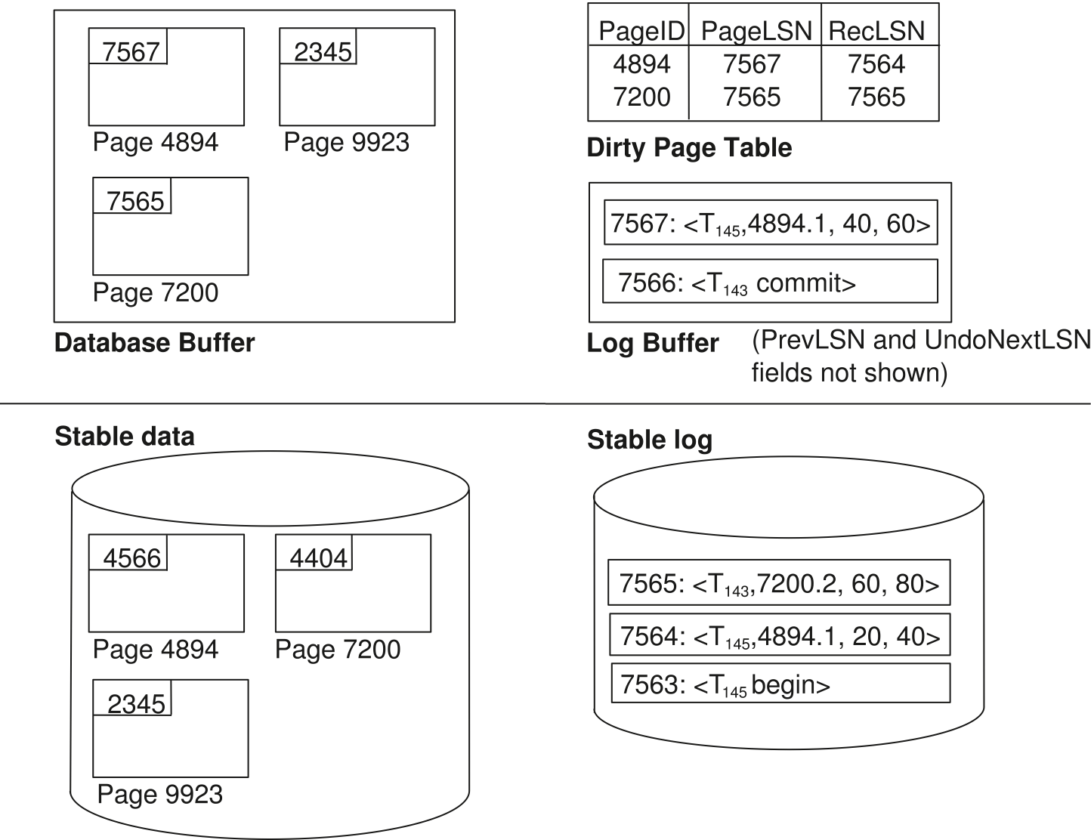
ARIES Data Structures

